Slide 1
Central limit theorem and confidence intervals
GEOG4300 /6300: Intro to data science
Prof. Jerry Shannon

Slide 2

Let’s talk about sampling!

Slide 3

Sample research question:
What are the most significant obstacles homeowners face in maintaining their homes? How does this vary by the homeowners’ age?

Slide 4
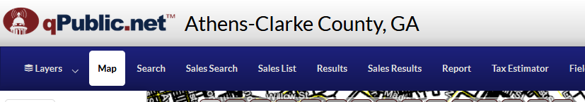
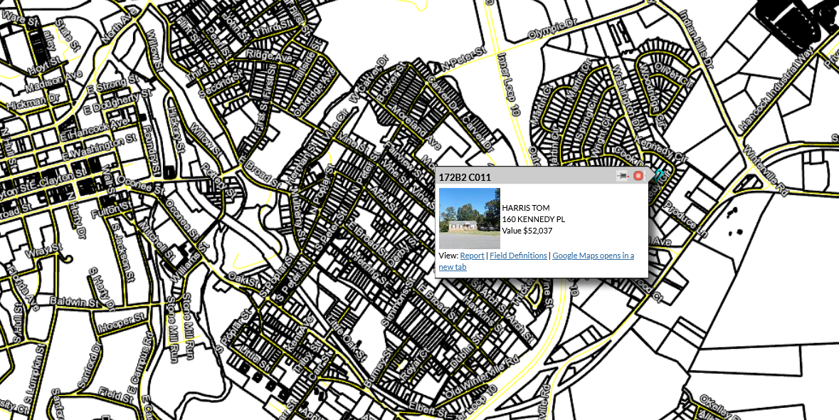
Sampling frame:
List of ALL possible households you could interview

Slide 5
Sampling strategy
Non-probability sample
Convenience
Snowball
Quota
Probability sample
Random
Systematic
Stratified
Cluster

Slide 6

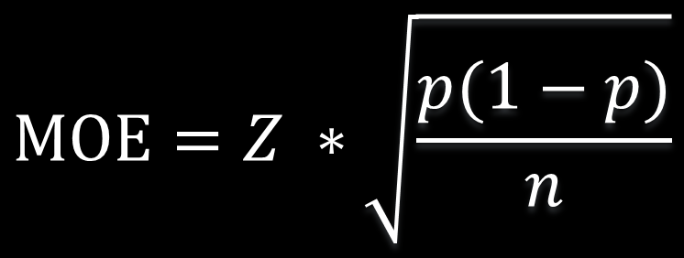
Sample size
$$MOE=Z ∗\sqrt{\frac{p(1−p)}{n}}$$
If the MOE for proportions is
Then we can compute sample size as
$$n=\frac{Z^{2}}{{MOE}^{2}}∗(p ∗\left(1−p\right))$$
We asked 20 homeowners if they were worried about losing their homes in the next year. Four said yes. What’s the confidence interval?
How big a sample would we need to get a margin of error of less than 1.5%?

